Slide 1

Annual General Meeting Report
13th November 2025
Benita Hexter

Slide 2
committee
Alison Lamb – Conference Curator
Benita Hexter - Chair
Carol Adcock – SCIC representative rep
Carolyn Taylor – Bursary Co-ordinator
Firas Sarhan – Social media
Rhiannon Daniel – Membership
Dan Burden – Newsletter Editor
Éimear Smith – Conference Curator
Emma Linley – Website
Emma Way – Conference Co-ordinator
Jane Stanbridge – Sponsorship
Kimberley Small - Secretary
Kirsty Cook – Treasurer
13 committee members
12/12 elected members
6/8 SCIC members

Slide 3
SCIC Reps
Belfast Bronagh Papenfus
Cardiff Kelly Morris
Dublin Eimear Smith
Glasgow Claire Lincoln
Middlesbrough Clare Nixon
Oswestry Jess Shiel
Salisbury Rachael Coulson-Smith
Sheffield Sarah Wilkinson and Andrea Patterson
Southport Clare Miller
Stanmore Sakshi Mahajan
Stoke Mandeville Firas Sarhan
Wakefield Zoe Jeffery and Fiona Dixon

Slide 4
accounts 2024-25
Expenditure | £30,212.26
Income | £39,282.99
Net Assets | 52964.76

Slide 5
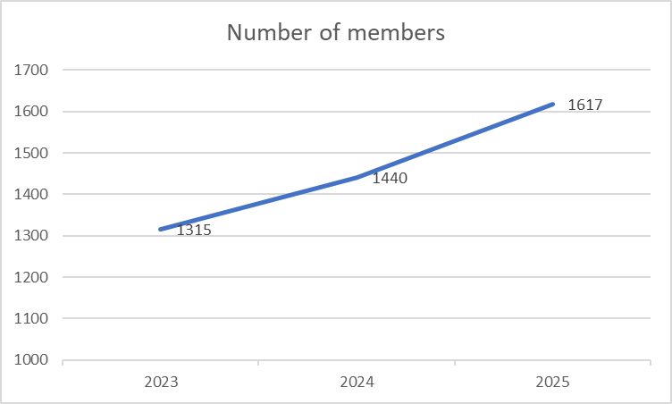
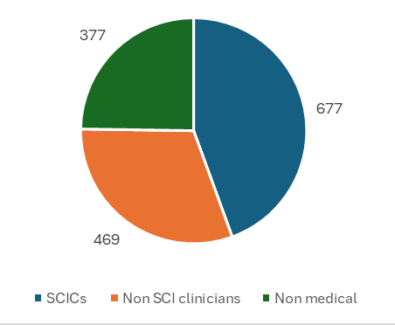
membership

Slide 6
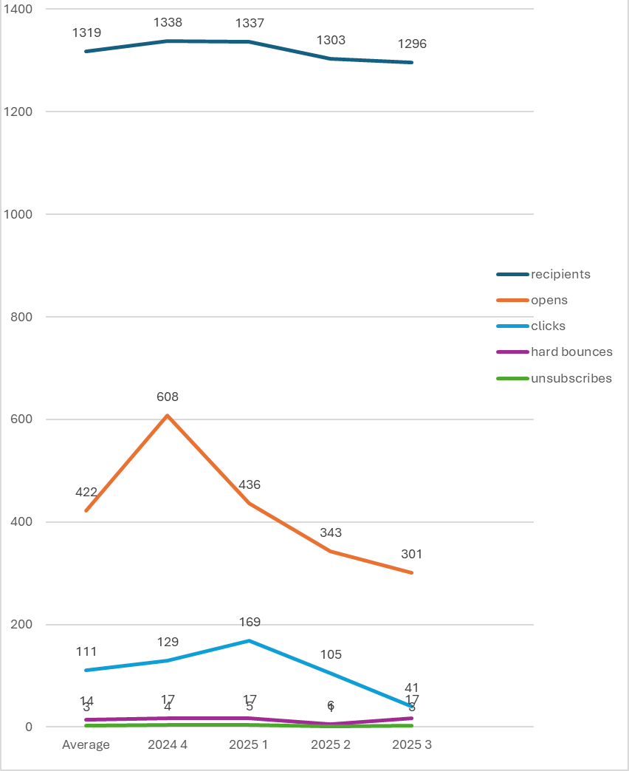
newsletter

Slide 7
website
2250 visitors per month

Slide 8
Activities, 2025
Rebuild website
Normalise tax affairs
Conference
Plans, 2026
Formalise status
Monthly webinars
Additional bursary
conference

Slide 9
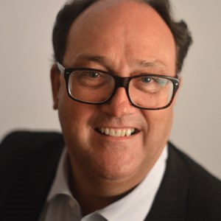
Paul Kennedy Bursary
Congratulations to Parvathy Mohan, who has been awarded the 2025 Paul Kennedy Bursary.
Parvathy is Nursing, Network Practice Educator at Sheffield SCIC and is aiming to produce a series of animated videos about bladder management

Slide 10
sponsorship
With thanks to:
Aspire Law
Bolt Burdon Kemp
Cauda Equina Champions Charity
Clinisupplies
Complexus Care
Emma Way Associates
HCA Healthcare
HCA Healthcare
Hollister / Fittleworth
Irwin Mitchell
Medstrom
Odstock Medical
Premium Care Solutions
Qufora
Stewarts Law
Tessa Gough Associates
Tetra Live-in Care
MASCIP is staffed by volunteers
Sponsorship opportunities range from £100 - £1,200
Used to finance MASCIP activities
Contact Jane Stanbridge at: mascipsponsorship@gmail.com

